Slide 1
13. Direct and Inverse Proportions

Slide 2
Direct Proportions

Slide 3
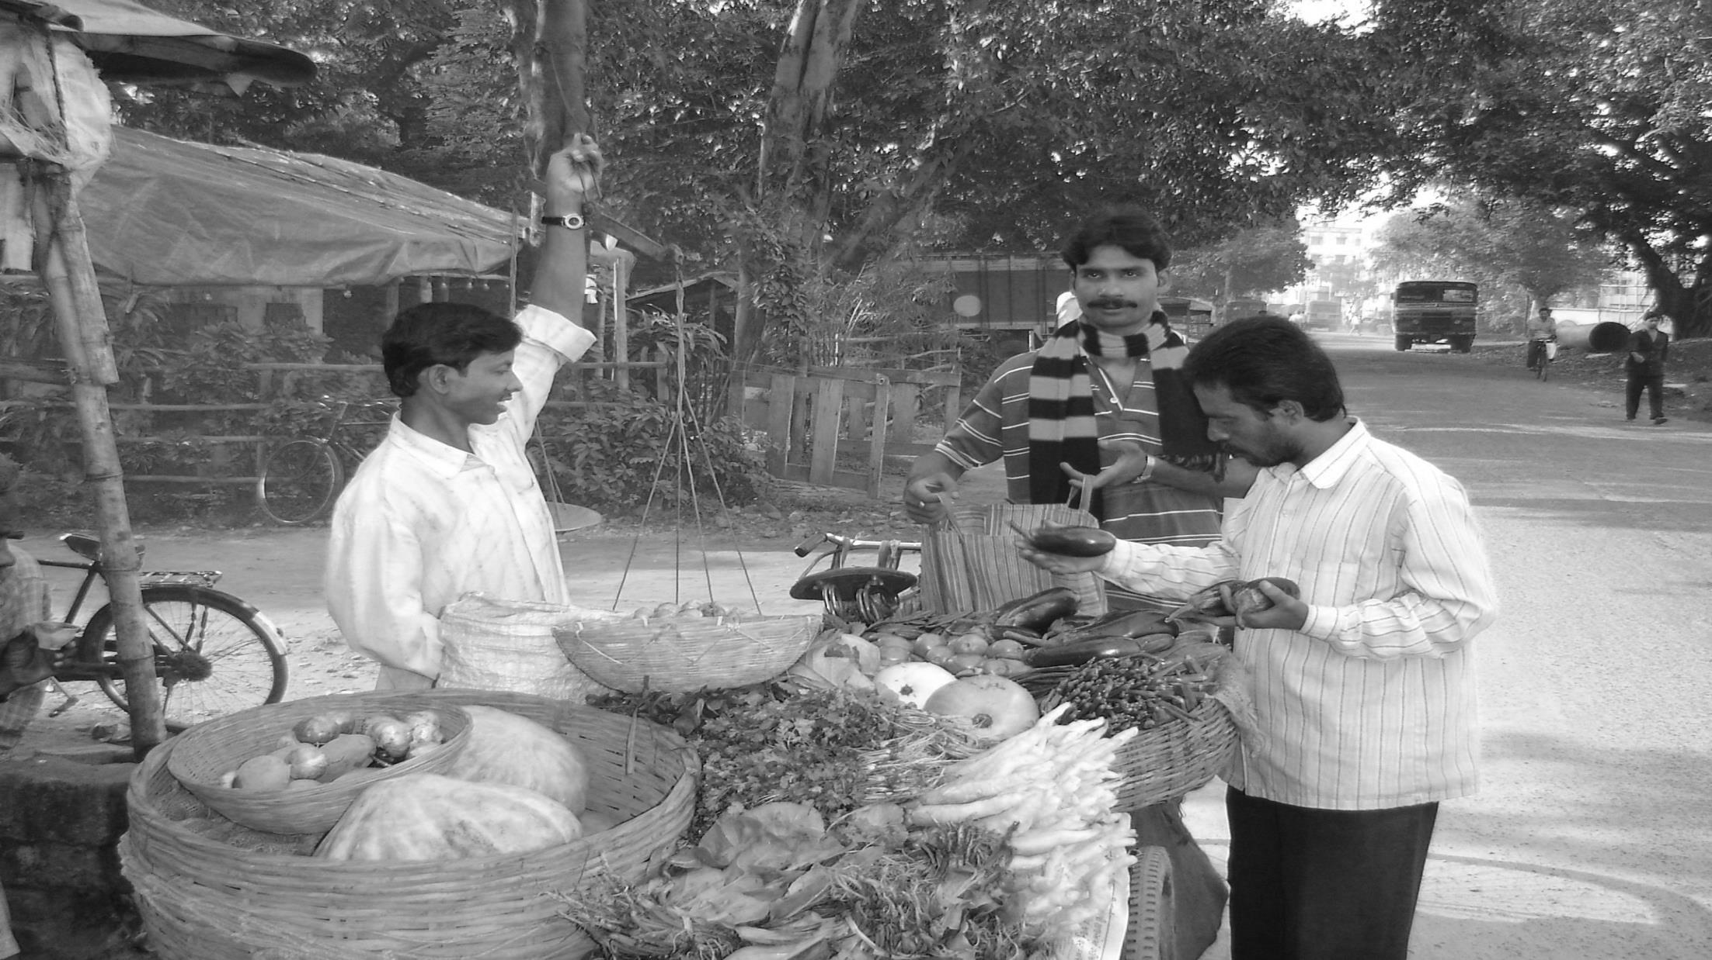
WEIGHT (Kg.)
1
3
AMOUNT (Rs.)
10
30
How Much For 1 Kg
So how much
for 3 Kg ?????
Rs. 10 Per Kg
Rs. 30

Slide 4
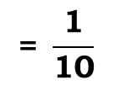
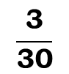
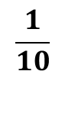
WEIGHT (Kg.)
1
3
AMOUNT (Rs.)
10
30
RATIO
1
$$\frac{\text{1}}{\text{10}}$$
$$\frac{\text{3}}{\text{30}}$$
$$\text{= }\frac{\text{1}}{\text{10}}$$
10
Both the ratios are equal

Slide 5
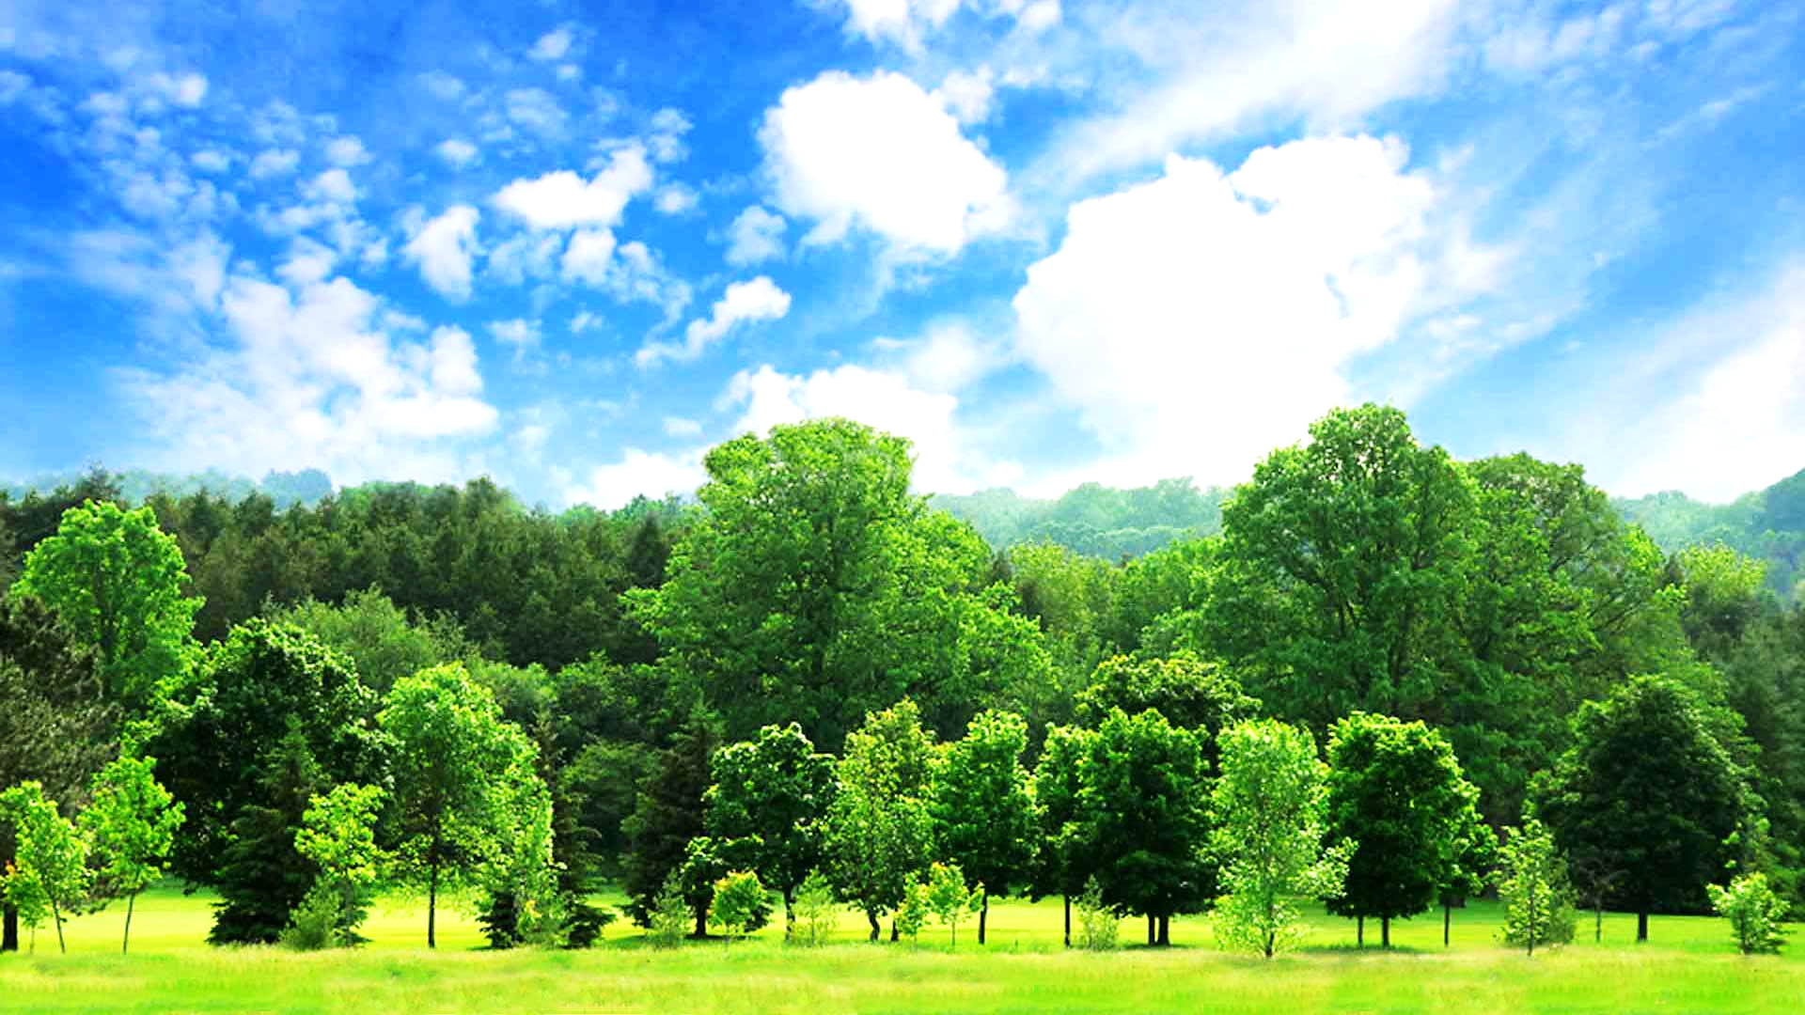

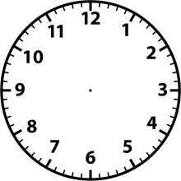




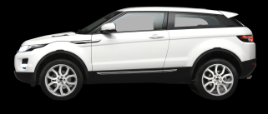



DIRECT VARIATIONS
Time (hours)
1
2
3
Distance (km)
60
120
180
180
60
120
Distance
=
60
=
60
3
=
60
∴
=
60
=
60
=
60
1
2
Time
In direct Variation ratio of
Quantities remain constant
Lets check ratio
Distance : Time
If one quantity increases and
other quantity also increases
0 km
This is the case of
120
km
120
km
60 km

Slide 6
DIRECT VARIATIONS AND DIRECT PROPERTION
WEIGHT Kg.
1
3
We MAY say this is a case of direct variation
But how to confirm ?
AMOUNT Rs.
`10
`30
If the ratio of the two quantities remain constant, this is a case of direct variation
Weight
Amount
If one variable increases and
other variable also increases

Slide 7
DIRECT VARIATIONS AND DIRECT PROPERTION
‘y’ varies directly as ‘x’
y

x
y
∴
=
k
Let us remove
‘’(alpha) sign
x
Whenever we have ‘k’, our first job is to remove ‘k’
In direct variation, the ratio is constant.

Slide 8



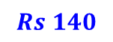
Example :
 The price of the scooter was 34000 last year. If it has increased by 20%
this year, what is the price now ?
The original price of the scooter
Let us take an example
i.e original
price + increase
Sol :
Original price of the scooter
=
Rs. 34000
Increase in %
=
20%
The amount is calculated as
20% of original price
=
20% of
34000
Let us see how to calculate increase/decrease in%
$$\frac{\text{20}}{\text{100}}$$
=
×
34000
Here, increase % is given. Hence we will calculate the amount of increase
=
20
×
340
=
6800
New price
=
Original price
+
Increase
=
34000
+
6800
=
Rs 40,800

Slide 9





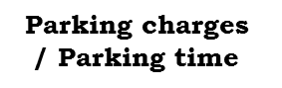
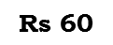
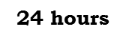
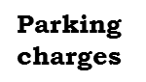
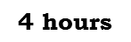
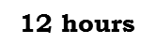
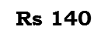
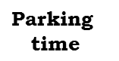
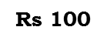
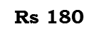
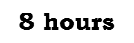
EXERCISE 13.1
 Following are the car parking charges near a railway station upto
4 hours
Rs. 60
Therefore we will take ratio of the quantities
8 hours
Rs. 100
12 hours
Rs. 140
24 hours
Rs. 180
Let us reduce the ratio in the lowest form
Check if the parking are in direct proportion to the parking time.
Sol :
Which are the two quantities that are varying ?
$$\text{Parking}$$
$$\text{time}$$
$$\text{Parking}$$
$$\text{charges}$$
$$\text{Parking} \text{charges}$$
/$\text{Parking} \text{time}$
Lets check whether the given Quantities are direct variation.
If the parking time increases then the parking charges will also increase
Therefore this is a case of direct variation
$$\text{4 }\text{hours}$$
$$\text{Rs}\text{ 60}$$
15
60
=
15
1
4
1
$$\text{8 }\text{hours}$$
25
100
=
25
$$\text{Rs}\text{ 100}$$
8
2
2
$$\text{12 }\text{hours}$$
35
140
=
35
$$\text{Rs}\text{ 140}$$
12
3
2
25
180
25
$$\text{24 }\text{hours}$$
$$\text{Rs}\text{ 180}$$
=
2
24
2
Since
15
≠
25
≠
35
≠
25
1
2
3
2
∴
The parking charges are not in direct proportion with the parking time.

Slide 10
EXERCISE 13.1
 A Mixture of paint is prepared by mixing 1 part of red pigments with 8 parts of base. In the following table. Find the parts of base that need to be added
Parts of red pigment
x₁
x₂
x₃
x₄
x₅
1
4
7
12
20
1
Parts of base
y₁
y₂
y₃
y₄
y₅
8
….
….
….
….
8
Which are the two quantities that are varying ?
Sol :
Let the red pigment be represented by x₁, x₂, x₃,..
And parts of base be denoted by y₁, y₂, y₃,,..
Therefore we will take the ratio of the quantities
As the part of red pigment increase, the required number of bases will also increase
It is a case of direct proportion.
i.e.
x₁
x₂
x₃
y₁
=
y₂
=
y₃
….
For
x₁
=
1,
y₁
=
8
∴
x₁
1
y₁
=
8

Slide 11
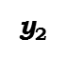
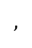

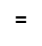
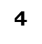
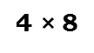
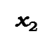

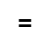
EXERCISE 13.1
 A Mixture of paint is prepared by mixing 1 part of red pigments with 8 parts of base. In the following table. Find the parts of base that need to be added
Parts of red pigment
1
4
4
7
12
20
Parts of base
8
$$\text{?}$$
….
….
….
….
32
Sol :
x₂
$$\text{x}\text{2}$$
$$\text{=}$$
$$\text{4}$$
$$,$$
$$\text{y}\text{2}$$
Now,
1
$$\text{=}$$
$$\text{?}$$
y₂
=
8
∴
4
1
y₂
=
8
∴
y₂
=
4 $\text{×}$8
∴
y₂
=
32

Slide 12
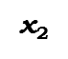
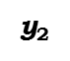
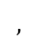

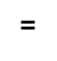

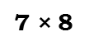
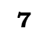
EXERCISE 13.1
 A Mixture of paint is prepared by mixing 1 part of red pigments with 8 parts of base. In the following table. Find the parts of base that need to be added
Parts of red pigment
1
4
7
7
12
20
Parts of base
8
….
$$\text{?}$$
32
….
….
….
56
Sol :
x₃
1
Now,
$$\text{x}\text{2}$$
$$\text{=}$$
$$\text{7}$$
$$,$$
$$\text{y}\text{2}$$
=
$$\text{=}$$
$$\text{?}$$
y₃
8
∴
7
1
y₃
=
8
∴
y₃
=
7 $\text{×}$8
∴
y₃
=
56

Slide 13
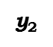

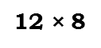
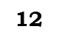
EXERCISE 13.1
 A Mixture of paint is prepared by mixing 1 part of red pigments with 8 parts of base. In the following table. Find the parts of base that need to be added
Parts of red pigment
1
4
7
12
12
20
Parts of base
8
….
….
$$\text{?}$$
32
56
….
….
96
Sol :
x₄
1
Now,
=
$$\text{x}\text{2}$$
$$\text{=}$$
$$\text{12}$$
$$,$$
$$\text{y}\text{2}$$
y₄
8
$$\text{=}$$
$$\text{?}$$
∴
12
1
y₄
=
8
∴
y₄
=
12 $\text{×}$8
∴
y₄
=
96

Slide 14
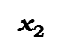

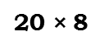
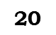
EXERCISE 13.1
 A Mixture of paint is prepared by mixing 1 part of red pigments with 8 parts of base. In the following table. Find the parts of base that need to be added
Parts of red pigment
1
4
7
12
20
20
Parts of base
8
….
….
….
$$\text{?}$$
32
56
96
….
160
Sol :
x₄
1
$$\text{x}\text{2}$$
$$\text{=}$$
$$\text{20}$$
$$,$$
$$\text{y}\text{2}$$
Now,
=
$$\text{=}$$
$$\text{?}$$
y₄
8
∴
20
1
y₄
=
8
∴
y₄
=
20 $\text{×}$8
∴
y₄
=
160
∴
Thus the required part of base are 8, 32, 56, 96, 160.

Slide 15
EXERCISE 13.1
 In question 2 above, if a part of a red pigment requires 75mL of base, how much red pigment we mix with 1800 ml of base?
Sol :
x₁
1
x₂
Which are the two quantities that are varying ?
We have,
=
=
Therefore we will take the ratio of the quantities
y₁
75
y₂
Therefore this is a case of direct variation
Here,
x₁
=
1
and
y₁
=
75
Parts of red pigment
And
Parts of base
1
x₂
=
75
1800
360
72
24
∴
x₂
=
1800
75
15
3
1
∴
Thus, the required red pigment = 24 parts.

Slide 16

EXERCISE 13.1
 A machine in a soft drink factory fills 840 bottles in six hours. How many bottles will it fill in five hours?
Therefore we will take the ratio of the quantities
Sol :
Number of bottles filled
Number of hours
Therefore this is a case of direct variation
Which are the two quantities that are varying ?
Lets assume it as x
840
6
x
5
Number of hours
Number of bottles filled
And
For more number of hours, more number of bottles would be filled.
840
6
x
=
5
∴
6x
=
5
$$\text{×}$$
840
∴
x
=
5
$$\text{×}$$
840
140
6
1
∴
x
=
700
∴
Thus, the required number of bottles = 700

Slide 17
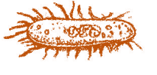

EXERCISE 13.1
 A photograph of a bacteria enlarged 50,000 times attains a length of 5 cm as shown in the diagram. What is the actual length of the bacteria? If the photograph is enlarged 20,000 times only, what would be its enlarged length?
Sol :
Length
Enlarged length
Which are the two quantities that are varying ?
5
50000
Enlarged length
x
20000
Length
And
Lets assume it as x
Actual length of bacteria
5
5
cm
=
=
50000
10000
=
10^{–4} cm
Here length and enlarged length of bacteria are indirect proportion
5
x
50000
=
20000
∴
50000x
=
5
$$\text{×}$$
20000
∴
x
1
2
=
5
$$\text{×}$$
20000
50000
10000
1
∴
x
=
2
∴
Hence enlarged length of bacteria is 2 cm.

Slide 18
EXERCISE 13.1
 In model of ship, the mast is 9 cm high, while the mast of actual ship is 12 cm high, if length of ship is 28 cm, how long is the model ship ?
Sol :
Length of the ship
Height of the mast
Therefore we will take the ratio of the quantities
Which are the two quantities that are varying ?
Therefore this is a case of direct variation
Lets assume it as x
28
12
x
9
Length of the ship
Height of the mast
And
Since, more the length of the ship, More would be the length of its mast.
28
12
x
=
9
∴
12x
=
28
$$\text{×}$$
9
∴
x
=
7
3
28
$$\text{×}$$
9
12
4
1
∴
x
=
21
∴
Thus, the required length of the model = 21 cm

Slide 19
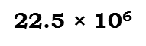

EXERCISE 13.1
 Suppose 2 kg of sugar contains 9 × 106 crystal. How many sugar crystals are there in (i) 5 kg of sugar : (ii) 1.2 kg of sugar ?
Sol :
Therefore we will take the ratio of the quantities
Number of bottles filled
Number of hours
Therefore this is a case of direct variation
Which are the two quantities that are varying ?
Lets assume it as x
2
9 × 10⁶
5
x
Weight of sugar
Number of crystal
And
For more number of hours, more number of bottles would be filled.
2
9 × 10⁶
=
x
5
∴
2x
=
5
$$\text{×}$$
9 × 10⁶
∴
5
$$\text{×}$$
9 × 10⁶
x
=
2
22.5
∴
45
$$\text{×}$$
10⁶
x
=
2
1
∴
x
=
22.5 $\text{×}$ 10⁶
∴
Thus, the required length of sugar crystal = 22.5 × 10⁶

Slide 20
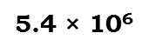
EXERCISE 13.1
 Suppose 2 kg of sugar contains 9 × 106 crystal. How many sugar crystals are there in (i) 5 kg of sugar : (ii) 1.2 kg of sugar ?
Sol :
Therefore we will take the ratio of the quantities
Number of bottles filled
Number of hours
Therefore this is a case of direct variation
Lets assume it as y
2
9 × 10⁶
1.2
y
For more number of hours, more number of bottles would be filled.
2
9 × 10⁶
=
y
1.2
∴
2y
=
1.2
$$\text{×}$$
9 × 10⁶
∴
1.2
$$\text{×}$$
9 × 10⁶
y
=
2
5.4
∴
10.8
$$\text{×}$$
10⁶
y
=
2
1
∴
y
=
5.4 $\text{×}$ 10⁶
∴
Thus, the required length of sugar crystal = 5.4 × 10⁶

Slide 21


EXERCISE 13.1
 Rashmi has a road map with a scale of 1 cm representing 18 km. She drives on
a road for 72 km. What would be her distance covered in the map?
Sol :
Therefore we will take the ratio of the quantities
Lets assume it as x
Therefore this is a case of direct variation
Actual distance in km
Distance covered
in map (in cm)
Which are the two quantities that are varying ?
18
1
Actual distance in km
And
Distance covered in map (in cm)
72
x
Here actual distance and distance covered in the map are in direct proportion.
18
72
=
x
1
∴
18
$$\text{×}$$
x
=
72
$$\text{×}$$
1
24
4
∴
72
$$\text{×}$$
1
x
=
18
2
1
∴
x
=
4
∴
Here distance covered in the map is 4

Slide 22
EXERCISE 13.1
 A 5m 60cm high vertical pole casts a shadow 3m 20cm long. Find at the same time (i) the length of the shadow cast by another pole 10m 50cm high and (ii) the height of a pole which casts a shadow 5m long.
Sol :
Which are the two quantities that are varying ?
Height of a pole
Length of a shadow
Lets assume it as x
Therefore we will take the ratio of the quantities
Therefore this is a case of direct variation
5m 60cm = 560
3m 20cm = 320
Actual distance in km
And
Distance covered in map (in cm)
10m 60cm = 1050
x cm
As the highest of the pole increases the length of its shadow also increases in the same ratio.
∴
1m
=
100cm
∴
5m
=
500cm
560
320
∴
5m 60cm
∴
1m
=
100cm
=
x
=
500 + 60
1050
∴
5m 60cm
∴
3m
=
300cm
=
560
∴
3m 20cm
∴
560
$$\text{×}$$
x
=
1050
$$\text{×}$$
320
=
300 + 20
∴
3m 20cm
4
150
∴
1m
=
100cm
=
320
∴
8
320
$$\text{×}$$
1050
x
=
560
∴
10m
=
1000cm
14
1000 + 50
1
7
∴
10m 50cm
=
∴
x
=
4
$$\text{×}$$
150
∴
10m 50cm
=
1050
∴
x
=
600
∴
Thus, the required length of the shadow is 600 cm of 6m

Slide 23
EXERCISE 13.1
 A 5m 60cm high vertical pole casts a shadow 3m 20cm long. Find at the same time (i) the length of the shadow cast by another pole 10m 50cm high and (ii) the height of a pole which casts a shadow 5m long.
Sol :
Height of a pole
Length of a shadow
Lets assume it as y
5m 60cm = 560
3m 20cm = 320
y cm
5m = 500
As the highest of the pole increases the length of its shadow also increases in the same ratio.
560
320
y
=
500
∴
320
$$\text{×}$$
y
=
560
$$\text{×}$$
500
125
7
∴
560
$$\text{×}$$
500
x
=
320
4
1
∴
x
=
125
$$\text{×}$$
7
∴
x
=
875
∴
Thus, the required height of a pole is 875cm or 8m 75 cm

Slide 24

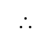
EXERCISE 13.1
 A loaded truck travels 14 km in 25 minutes. If the speed remains the same, how far can it travel in 5 hours?
Sol :
Let distance covered in 5 hours be x km.
$$$$
1 hour = 60 minutes
$$$$
5 hours = 5 × 60 = 300 minutes
Distance (in km)
Time (in minutes)
14
25
x
300
Here distance covered and time in direct proportion
∴
14
x
=
25
300
∴
x
$$\text{×}$$
25
=
14
$$\text{×}$$
300
14
$$\text{×}$$
300
60
12
∴
x
=
25
5
1
∴
x
=
168 cm
∴
Hence, the distance covered in 5 hours is 168 km.

Slide 25
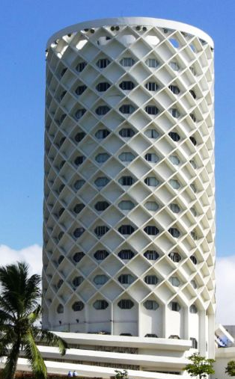
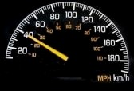
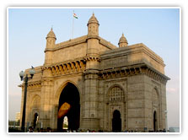

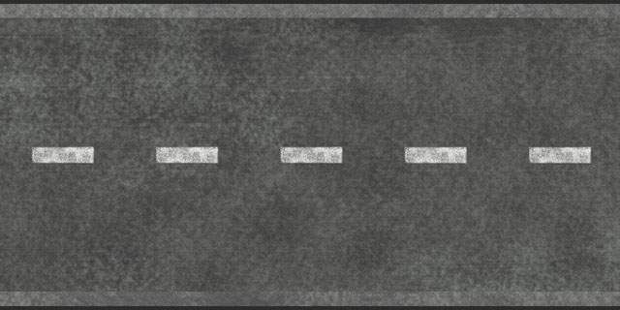
SPEED
TIME TAKEN
40 km/hr
4 hours

Slide 26
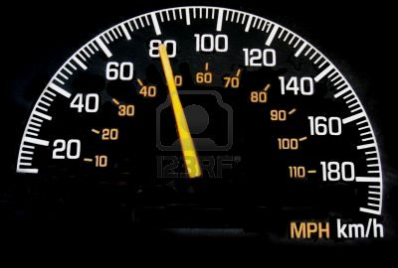
SPEED
TIME TAKEN
40 km/hr
4 hours
80 km/hr
2 hours

Slide 27
SPEED
TIME TAKEN
PRODUCT
40 km/hr
4 hours
40 × 4 = 160
80 km/hr
2 hours
80 × 2 = 160
INVERSE VARIATION
OR
INVERSE PROPORTION
We MAY say this is a case of inverse variation
If the product of the two quantities remain constant, this is a case of inverse variation
If one variable increases and other variable decreases.
But how to confirm ?
TIME
SPEED

Slide 28
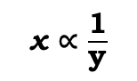
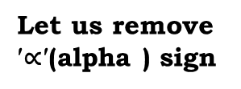

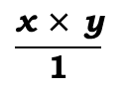
INVERSE VARIATION
OR
INVERSE PROPORTION
x $\text{∝}$ $\frac{\text{1}}{\text{y}}$
‘x’ varies inversely as ‘y’
Let us remove $\text{′∝′}$(alpha ) sign
$$\frac{\text{x} \text{×} \text{y}}{\text{1}}$$
= k
... [where k is a non-zero
constant of variation]
$\text{∴}$ x × y = k
Whenever we have ‘k’, our first job is to remove ‘k’
In inverse variation, the product is constant.

Slide 29
Inverse Proportions

Slide 30
EXERCISE 13.2
 Which of the following are in inverse proportion ?
1. The number of workers on a job and the time to complete the job
Sol :
If number of workers are increased then time to complete the job would decrease.
Hence, it is not a case if inverse variation
2. The time taken for a journey and the distance travelled in a uniform speed.
Sol :
For longer distance, more time would be required.
Hence, it is not a case if inverse variation
3. Area of cultivated land and the crop harvested.
Sol :
It is a direct proportion because more are of cultivated land will yield more crops.

Slide 31
EXERCISE 13.2
 Which of the following are in inverse proportion ?
4. The time taken for a fixed journey and the speed of the vehicle
Sol :
Time and speed are inverse proportion because if time is less, speed is more.
5. The population of a country and the area of land per person.
Sol :
For more population, less area per person would be required.
Hence, it is not a case if inverse variation

Slide 32










EXERCISE 13.2
 In a television game show, the prize money of Rs. 1,00,000 is to be divided equally amongst the winners. Compete the following table and find whether the prize money given to an individual winner is directly or inversely proportional to the number of winners ?
Which are the two quantities that are varying ?
Number of winners
And
Prize for each winner (in Rs.)
$$\text{4}$$
Number of winners
1
2
x₁
x₂
x₃
x₄
x₅
4
5
8
10
20
4
$$\text{?}$$
Prize for each winner (in Rs.)
1,00,000
50,000
y₁
y₂
y₃
y₄
y₅
𝟐𝟓𝟎𝟎𝟎
Sol :
Therefore this is a case of direct variation
Therefore we will take the product
If more the numbers of winners, less is the prize money.
Let the number of winners be represented by x₁, x₂, x₃
$$\text{=}$$
$$,$$
$$\text{x}\text{1}$$
$$\text{4}$$
$$\text{y}\text{1}$$
$$\text{=}$$
$$\text{?}$$
Let us reduce it to the lowest form
∴
x₁
$$\text{×}$$
y₁
=
1
$$\text{×}$$
100000
∴
4
$$\text{×}$$
y₁
=
1
$$\text{×}$$
100000
And the prize of each winner represented by y₁, y₂, y₃
1
$$\text{×}$$
100000
25000
∴
y₁
=
4
1
∴
y₁
=
25000
∴
y₁ = 25,000

Slide 33






EXERCISE 13.2
 In a television game show, the prize money of Rs. 1,00,000 is to be divided equally amongst the winners. Compete the following table and find whether the prize money given to an individual winner is directly or inversely proportional to the number of winners ?
Number of winners
1
2
4
$$\text{5}$$
5
8
10
20
Prize for each winner (in Rs.)
1,00,000
50,000
$$\text{?}$$
$$\text{?}$$
𝟐𝟓𝟎𝟎𝟎
𝟐𝟎𝟎𝟎𝟎
Sol :
Therefore this is a case of direct variation
Let us reduce it to the lowest form
Therefore we will take the product
If more the numbers of winners, less is the prize money.
x₁
$$\text{=}$$
y₁
$$,$$
$$\text{5}$$
$$\text{=}$$
$$\text{?}$$
∴
x₁
$$\text{×}$$
y₁
=
1
$$\text{×}$$
100000
∴
5
$$\text{×}$$
y₁
=
1
$$\text{×}$$
100000
y₁
1
$$\text{×}$$
100000
20000
∴
=
5
1
∴
y₁
=
20000
∴
y₁ = 20,000

Slide 34







EXERCISE 13.2
 In a television game show, the prize money of Rs. 1,00,000 is to be divided equally amongst the winners. Compete the following table and find whether the prize money given to an individual winner is directly or inversely proportional to the number of winners ?
Number of winners
1
2
4
5
$$\text{8}$$
8
10
20
Prize for each winner (in Rs.)
1,00,000
50,000
$$\text{?}$$
$$\text{?}$$
𝟐𝟓𝟎𝟎𝟎
𝟐𝟎𝟎𝟎𝟎
12500
Sol :
Therefore this is a case of direct variation
Let us reduce it to the lowest form
Therefore we will take the product
If more the numbers of winners, less is the prize money.
x₁
$$\text{=}$$
y₁
$$,$$
$$\text{8}$$
$$\text{=}$$
$$\text{?}$$
∴
x₁
$$\text{×}$$
y₁
=
1
$$\text{×}$$
100000
∴
8
$$\text{×}$$
y₁
=
1
$$\text{×}$$
100000
1
$$\text{×}$$
100000
12500
∴
y₁
=
8
1
∴
y₁
=
12,500
∴
y₁ = 12,500

Slide 35


EXERCISE 13.2
 In a television game show, the prize money of Rs. 1,00,000 is to be divided equally amongst the winners. Compete the following table and find whether the prize money given to an individual winner is directly or inversely proportional to the number of winners ?
Number of winners
1
2
4
5
8
$$\text{10}$$
10
20
Prize for each winner (in Rs.)
1,00,000
50,000
$$\text{?}$$
$$\text{?}$$
𝟐𝟓𝟎𝟎𝟎
𝟐𝟎𝟎𝟎𝟎
12500
10000
Sol :
Therefore this is a case of direct variation
Let us reduce it to the lowest form
Therefore we will take the product
If more the numbers of winners, less is the prize money.
x₁
$$\text{=}$$
y₁
$$,$$
$$\text{8}$$
$$\text{=}$$
$$\text{?}$$
∴
x₁
$$\text{×}$$
y₁
=
1
$$\text{×}$$
100000
∴
10
$$\text{×}$$
y₁
=
1
$$\text{×}$$
100000
1
$$\text{×}$$
100000
10000
∴
y₁
=
10
1
∴
y₁
=
10,000
∴
y₁ = 10000

Slide 36


EXERCISE 13.2
 In a television game show, the prize money of Rs. 1,00,000 is to be divided equally amongst the winners. Compete the following table and find whether the prize money given to an individual winner is directly or inversely proportional to the number of winners ?
Number of winners
1
2
4
5
8
10
$$\text{20}$$
20
Prize for each winner (in Rs.)
1,00,000
50,000
$$\text{?}$$
$$\text{?}$$
𝟐𝟓𝟎𝟎𝟎
𝟐𝟎𝟎𝟎𝟎
12500
10000
5000
Sol :
Therefore this is a case of direct variation
Let us reduce it to the lowest form
Therefore we will take the product
If more the numbers of winners, less is the prize money.
x₁
$$\text{=}$$
y₁
$$,$$
$$\text{8}$$
$$\text{=}$$
$$\text{?}$$
∴
x₁
$$\text{×}$$
y₁
=
1
$$\text{×}$$
100000
∴
20
$$\text{×}$$
y₁
=
1
$$\text{×}$$
100000
1
$$\text{×}$$
100000
5000
∴
y₁
=
20
1
∴
y₁
=
5,000
∴
y₁ = 5,000

Slide 37



EXERCISE 13.2
 Rehman is making a wheel using spokes. He wants to fix equal spokes in such a
way that the angles between any pair of consecutive spoke are equal. Help him by completing the following table.
$$\text{8}$$
x₁
x₂
x₃
Number of spokes
4
6
8
10
12
8
Angle between a pair of consecution spokes
y₁
y₂
y₃
90º
60º
$$\text{?}$$
45º
Are the number of spokes and the angles formed between
the pairs of consecutive spokes in inverse proportion ?
$$\text{=}$$
$$,$$
$$\text{x}\text{1}$$
8
$$\text{y}\text{1}$$
$$\text{=}$$
$$\text{?}$$
And the angle represented by y1, y2, y3
Let the number of spokes be represented by x₁, x₂, x₃
Sol :
Are the number of spokes and the angles formed
between the pairs of consecutive spokes in inverse proportion .
Which are the two quantities that are varying ?
Therefore this is a case of direct variation
Let us reduce it to the lowest form
Therefore we will take the product
If more the numbers of winners, less is the prize money.
Number of spokes
And
Angle between a pair of consecutive spokes
∴
x₁
$$\text{×}$$
y₁
=
4
$$\text{×}$$
90º
∴
8
$$\text{×}$$
y₁
=
4
$$\text{×}$$
90º
1
4
$$\text{×}$$
90º
∴
y₁
=
8
2
∴
y₁
=
45º
∴
y₁ = 45º

Slide 38





EXERCISE 13.2
 Rehman is making a wheel using spokes. He wants to fix equal spokes in such a
way that the angles between any pair of consecutive spoke are equal. Help him by completing the following table.
$$\text{10}$$
Number of spokes
4
6
8
10
12
10
Angle between a pair of consecution spokes
$$\text{?}$$
90º
60º
45º
36º
Are the number of spokes and the angles formed between
the pairs of consecutive spokes in inverse proportion ?
Therefore we will take the product
$$,$$
$$\text{x}\text{1}$$
$$\text{y}\text{1}$$
$$\text{=}$$
10
$$\text{=}$$
$$\text{?}$$
Sol :
Are the number of spokes and the angles formed
between the pairs of consecutive spokes in inverse proportion .
If more the numbers of winners, less is the prize money.
∴
x₁
$$\text{×}$$
y₁
=
4
$$\text{×}$$
90º
∴
10
$$\text{×}$$
y₁
=
4
$$\text{×}$$
90º
4
$$\text{×}$$
90º
∴
y₁
=
10
∴
y₁
=
36º
∴
y₁ = 36º

Slide 39

EXERCISE 13.2
 Rehman is making a wheel using spokes. He wants to fix equal spokes in such a
way that the angles between any pair of consecutive spoke are equal. Help him by completing the following table.
10
$$\text{12}$$
Number of spokes
4
6
8
12
12
Angle between a pair of consecution spokes
$$\text{?}$$
90º
60º
45º
36º
30º
Are the number of spokes and the angles formed between
the pairs of consecutive spokes in inverse proportion ?
Therefore we will take the product
$$,$$
$$\text{x}\text{1}$$
$$\text{y}\text{1}$$
$$\text{=}$$
12
$$\text{=}$$
$$\text{?}$$
Sol :
Are the number of spokes and the angles formed
between the pairs of consecutive spokes in inverse proportion .
If more the numbers of winners, less is the prize money.
∴
x₁
$$\text{×}$$
y₁
=
4
$$\text{×}$$
90º
∴
12
$$\text{×}$$
y₁
=
4
$$\text{×}$$
90º
1
30
4
$$\text{×}$$
90º
∴
y₁
=
12
3
1
∴
y₁
=
30º
∴
y₁ = 30º

Slide 40
EXERCISE 13.2
 Rehman is making a wheel using spokes. He wants to fix equal spokes in such a
way that the angles between any pair of consecutive spoke are equal. Help him by completing the following table.
Number of spokes
4
6
8
10
12
Angle between a pair of consecution spokes
90º
60º
45º
36º
30º
Calculate the angle between a pair of consecutive
spokes on a wheel with 15 spokes.
Therefore we will take the product
$$,$$
$$\text{x}\text{1}$$
$$\text{y}\text{1}$$
$$\text{=}$$
15
$$\text{=}$$
$$\text{?}$$
Sol :
Calculate the angle between a pair of consecutive
spokes on a wheel with 15 spokes.
If more the numbers of winners, less is the prize money.
∴
x₁
$$\text{×}$$
y₁
=
4
$$\text{×}$$
90º
∴
15
$$\text{×}$$
y₁
=
4
$$\text{×}$$
90º
4
$$\text{×}$$
6
90º
∴
y₁
=
15
1
∴
y₁
=
24º
∴
y₁ = 24º

Slide 41
EXERCISE 13.2
 Rehman is making a wheel using spokes. He wants to fix equal spokes in such a
way that the angles between any pair of consecutive spoke are equal. Help him by completing the following table.
Number of spokes
4
6
8
10
12
Angle between a pair of consecution spokes
90º
60º
45º
36º
30º
(iii) How many spokes would be needed, if the angle between a pair of consecutive spokes is 40º ?
Therefore we will take the product
$$,$$
$$\text{x}\text{1}$$
$$\text{y}\text{1}$$
$$\text{=}$$
40
$$\text{=}$$
$$\text{?}$$
Sol :
(ii) Let the required number of spoke be n.
∴
40
$$\text{×}$$
n
=
4
$$\text{×}$$
90º
1
4
$$\text{×}$$
90º
∴
n
=
40
1
∴
n
=
9º
∴
The required number of spoke is 9º.

Slide 42
EXERCISE 13.2
 If a box of sweets is divided among 24 children, they will get 5 sweets each. How many would each get, if the number of the children is reduced by 4 ?
Sol :
Lets assume it as x
Which are the two quantities that are varying ?
Therefore this is a case of inverse variation
children
Distance
24
5
Children
And
Sweets
Let us find the number of children reduced by 4.
By how many children are they reduced ?
20
n
What are the total number of children ?
Therefore it is a case of inverse variation
Therefore we will take the product
Let us reduce it to the lowest form
Reduced number of children
=
24
–
4
=
20
Since, more the number of children, less is the quantity of sweets.
∴
20
$$\text{×}$$
n
=
24
$$\text{×}$$
5
∴
6
1
24
$$\text{×}$$
5
n
=
20
4
1
∴
n
=
6
∴
Each student will get 6 sweets.

Slide 43
EXERCISE 13.2
 A farmer has enough food to feed 20 animals in cattle for 6 days. How would the food last were 10 more animals in his cattle ?
Sol :
Lets assume it as x
Which are the two quantities that are varying ?
Therefore this is a case of inverse variation
Animals
Days
20
6
x
Animals
And
Days
30
Reduced number of children
=
20
+
10
=
30
For more number of animals, the food will last less number of days.
Let us find the number of animals if they are increased
But how many animals are they added ?
What are the total number of animals ?
Therefore it is a case of inverse variation
Let us reduce it to the lowest form
Therefore we will take the product
∴
30
$$\text{×}$$
x
=
20
$$\text{×}$$
6
∴
4
1
20
$$\text{×}$$
6
x
=
30
5
1
∴
x
=
4
∴
Therefore, the food will now last for 4 days.

Slide 44
EXERCISE 13.2
 A contractor estimates that 3 persons could rewire Jasminder’s house in 4 days. If, he uses 4 persons instead of three, how long should they take to complete the job?
Sol :
Which are the two quantities that are varying ?
Person
Days
Therefore we will take the ratio of the quantities
Therefore this is a case of direct variation
Lets assume it as x
3
4
4
x
Person
And
Days
Here the number of persons and the number of days are in inverse proportion.
3
x
=
4
4
∴
4
$$\text{×}$$
x
=
3
$$\text{×}$$
4
∴
3
$$\text{×}$$
1
x
4
=
4
1
∴
x
=
3
∴
Here, they will complete the in 3 days.

Slide 45
EXERCISE 13.2
 A batch of bottles was packed in 25 boxes with 12 bottles in each box. If the same batch is packed using 20 bottles in each box, how many boxes would be filled?
Sol :
Which are the two quantities that are varying ?
Number of bottles in each box
Therefore we will take the ratio of the quantities
boxes
Therefore this is a case of direct variation
Lets assume it as x
12
25
Person
And
Days
20
x
Here the number of persons and the number of days are in inverse proportion.
12
x
=
20
25
∴
20
$$\text{×}$$
x
=
12
$$\text{×}$$
25
∴
3
5
x
12
$$\text{×}$$
25
=
20
4
1
∴
x
=
15
∴
Here, 15 boxes would be filled.

Slide 46
EXERCISE 13.2
 A factory requires 42 machines to produce a given number of articles in 63 days. How many machines would be required to produce the same number of articles in 54 days?
Sol :
Which are the two quantities that are varying ?
Number of bottles in each box
Therefore we will take the ratio of the quantities
boxes
Therefore this is a case of direct variation
Lets assume it as x
63
42
Number of bottles in each box
And
Boxes
54
x
Here the number of persons and the number of days are in inverse proportion.
63
x
=
54
42
∴
54
$$\text{×}$$
x
=
63
$$\text{×}$$
42
∴
3
21
x
63
$$\text{×}$$
42
=
54
27
1
∴
x
=
49
∴
Here, 49 machines would be required.

Slide 47
EXERCISE 13.2
 A car takes 2 hours to reach a destination by travelling at the speed of 60 km/h. How long will it take when the car travels at the speed of 80 km/h
Sol :
Which are the two quantities that are varying ?
Therefore we will take the ratio of the quantities
Speed km/h
Number of hours
Therefore this is a case of direct variation
Lets assume it as x
60
2
And
Number of hours
80
x
Speed km/h
Here the number of persons and the number of days are in inverse proportion.
60
x
=
80
2
∴
80
$$\text{×}$$
x
=
60
$$\text{×}$$
2
∴
3
1
x
60
$$\text{×}$$
2
=
80
2
4
∴
x
=
3
2
3
∴
Thus, the required number of hours
hours
2

Slide 48
EXERCISE 13.2
 Two persons could fit new windows in a house in 3 days
(i) One of the persons fell ill before the work started. How long would the job take now?
Sol :
Which are the two quantities that are varying ?
Therefore we will take the ratio of the quantities
Persons
Days
Therefore this is a case of direct variation
Lets assume it as x
2
3
And
Number of hours
1
x
Speed km/h
Here the number of persons and the number of days are in inverse proportion.
2
x
=
1
3
∴
1
x
$$\text{×}$$
=
2
$$\text{×}$$
3
∴
x
2
$$\text{×}$$
3
=
1
∴
x
=
6
1
∴
x
=
6

Slide 49





















Two persons could fit new windows in a house in 3 days
Q.
(ii) How many persons would be needed to fit the windows in one day?
Sol.
Let the number of persons be x.
$$\text{Persons}$$
$$\text{Days}$$
$$\text{2}$$
$$\text{x}$$
$$\text{3}$$
$$\text{1}$$
Here, the number of persons and the number of days are in inverse proportion.
$$\frac{\text{2} }{\text{1}}$$
$$\frac{ \text{x} }{\text{3}}$$
$$$$
$$\text{=}$$
$$\text{=}$$
$$\text{x} \text{×}\text{ 1}$$
$$\text{=}$$
$$\text{2 }\text{×}\text{ 3}$$
$$\frac{\text{2 }\text{×}\text{ 3}}{\text{1}}$$
$$x$$
$$\text{6 }\text{persons}$$
$$\text{=}$$
$$\text{=}$$
$$\text{=}$$

Slide 50


















A school has 8 periods a day each of 45 minutes duration. How long would each period be, if the school has 9 periods a day, assuming the number of school hours to be the same?
Q.
Sol.
Let the duration of each period be x.
$$\text{Period}$$
$$\text{Duration} \text{of} \text{period}$$
$$\text{(}\text{in} \text{minutes}\text{)}$$
$$\text{8}$$
$$\text{45}$$
$$\text{9}$$
$$\text{x}$$
Here the number of periods and the duration of periods are in inverse proportion.
$$\frac{\text{8} }{\text{9}}$$
$$\frac{\text{x} }{\text{45}}$$
$$$$
$$=$$
$$\text{x} \text{×}\text{ 9}$$
$$\text{=}$$
$$\text{8 }\text{×}\text{ 45}$$
$$\frac{\text{8} \text{×} \text{45}}{\text{9}}$$
$$\text{x}$$
$$\text{=}$$
$$\text{40 }\text{cm}$$
$$\text{=}$$
Hence, the duration of each period would be 40 minutes.

Slide 51

Time and Work

Slide 52

INTRODUCTION
Q.No.1 Suppose A can finish a piece of work in 8 days.
Then work done by A in 1 day
Eq. Suppose that the work done by A in 1 day is
1
6
Then, time taken by A to finish the whole work = 6 days

Slide 53
GENERAL RULES
Q.No.1 Suppose A can finish a piece of work in n days.
1
Then, work done by A in 1 day =
Lets take an example to understand the rule
n
Eq. Suppose that the work done by A in 1 day is
1
6
Then, time taken by A to finish the whole work = 6 days

Slide 54

EXAMPLE
 A alone can finish a piece of work in 12 days and B alone can do it in 15 days.
If both of them work at it together, how much time will they take to finish it ?
Sol :
Time taken by (A + B) to finish the work
=
12 days
Time taken by B alone to finish the work
=
15 days
1
Work done by A in 1 day
=
12
6
1
3
20
Work done by A in 1 day
=
–
9
15
1
1
11
Work done by (A + B) in 1 day
=
+
12
15
3
9
3
=
=
60
20
20
Time taken by (A + B) to finish the work
20
days, i.e.
2
=
6
days
3
3
2
Hence, both can finish the work in
∴
6
3
days

Slide 55
EXAMPLE
 A and B together can do a piece of work in 12 days, while B alone can finish it in 30 days. In how many days can A alone finish the work?
Sol :
Time taken by (A + B) to finish the work
=
12 days
Time taken by B alone to finish the work
=
30 days
1
∴
(A + B)’s 1 day’s work
=
12
1
∴
B’s 1 day’s work
=
30
∴
A’s 1 day’s work
=
(A + B)’s 1 day’s work
–
B’s 1 day’s work
1
1
=
–
12
30
1
3
1
=
=
60
20
20
∴
Alone can finish the work in 20 days.

Slide 56

A cistern or a water rank is connected with two types of pipes
Inlet :
Outlet :
The pipe which
fills the tank
is called as inlet
The pipe which
fills the tank
is called as inlet
Rule : 1
Suppose a pipe fills a tank in n hours
1
Then, part of the tank filled in 1 hour =
n
i.e., work done by the inlet in
1
1 hour =
n

Slide 57
A cistern or a water rank is connected with two types of pipes
Inlet :
Outlet :
The pipe which
fills the tank
is called as inlet
The pipe which
fills the tank
is called as inlet
Rule : 2
Suppose an outlet empties a full tank in m hours
1
Then, part of the tank emptied in 1 hour =
m
i.e., work done by the inlet in
1
1 hour =
m

Slide 58

Additional sums

Slide 59


EXERCISE
 If x and y vary directly, find the missing entries in the following table :
(i)
x
2.5
….
….
21
y
5
8
24
….
Sol :
(i)
It is given that x and y are in direct variation. Therefore, the ratio of
the corresponding values of x and y remain constant.
We have,
2.5
1
=
5
2
So, x and y are in direct variation with the
constant of variation equal to
1
2
This means that
x is half of y
or y is twice of x.
Thus, the required entries are
x
$$\frac{\text{1}}{\text{2}}$$
x
$$\frac{\text{1}}{\text{2}}$$
21
$$\frac{\text{1}}{\text{2}}$$
8
=
=
x
=
24
Thus, the required entries are
x
=
$$\frac{\text{1}}{\text{2}}$$
x
=
$$\frac{\text{1}}{\text{2}}$$
21
=
$$\frac{\text{1}}{\text{2}}$$
×
8
×
24
×
x
4, 12 and 42.
x
=
4
x
=
12
x
=
42
21
× 2

Slide 60


EXERCISE
 If x and y vary directly, find the missing entries in the following table :
(ii)
x
….
9
15
….
y
3
4.5
7.5
13.25
Sol :
(ii)
We have,
9
15
=
=
2
4.5
4.5
So, x and y are in direct variation such that x is twice of y.
x
x
y
=
2
y
=
2
$$\frac{\text{x}}{\text{3}}$$
=
2
$$\frac{\text{x}}{\text{13.25}}$$
=
2
×
3
26.50
x
=
2
x
=
2
×
13.25
3
Thus, the missing entries are
6 and 26.50

Slide 61
EXERCISE
 A car travels 432 km on 48 liters of petrol. How far would it travel
on 20 liters of petrol ?
Sol :
Suppose the car travels x km on 20 liters of petrol. Then, the above information car be put in the following tabular form
Which are the two quantities that are varying ?
Petrol (in liters)
Distance (in km)
Therefore we will take the ratio of the quantities
Therefore this is a case of direct variation
432
Lets assume it as x
48
20
x
And
Number of hours
Speed km/h
We observe that the lesser that the lesser he petrol consumed, the smaller the number of kilometers travelled. So, it is a case of direct variation.
48
432
=
20
x
∴
48
$$\text{×}$$
x
=
20
$$\text{×}$$
432
∴
10
216
18
x
20
$$\text{×}$$
432
=
48
12
24
1
∴
x
=
180
∴
Hence, the car would travel 180 km on 20 liters of petrol.

Slide 62
EXERCISE 13.1
 Reema types 540 words during half an hour. How many words would she type in 6 minutes ?
Sol :
Suppose she types x word in 6 minutes. Then, the given information can be exhibited in the following tabular form.
Number of words
Time (in minutes)
Which are the two quantities that are varying ?
Therefore we will take the ratio of the quantities
Therefore this is a case of direct variation
Lets assume it as x
540
30
x
6
Length of the ship
Height of the mast
And
Since in more time words can be typed. So, it is a case of direct variation.
540
30
x
=
6
∴
30
$$\text{×}$$
x
=
540
$$\text{×}$$
6
∴
x
=
540
2
$$\text{×}$$
6
30
1
∴
x
=
108
∴
Hence, she types 108 words in 6 minutes.

Slide 63
EXERCISE
 The amount of extension in an elastic spring varies directly as the weight hung on it. If a weight of 150 gm produces an extension of 2.9 cm, then what weight would produce an extension of 17.4 cm ?
Sol :
Let the required weight be x gram. Then, the above information can be exhibited in the following tabular form :
Weight (in gram)
150
x
Distance (in km)
2.9
17.4
It is given that the amount of extension in the spring varies directly as the weight hung on it. So, it is a case of direct variation.
∴
Ratio of petrol consumed
=
Ratio of distance travelled
∴
150 : x
=
2.9 : 17.4
150
2.9
∴
x
=
17.4
150
1
∴
x
=
6
∴
150 × 6
=
1 × x
∴
x
=
∴
Hence, a weight of 900 gram would produce an extension of 17.4 cm.

Slide 64
EXERCISE
 If a and b vary inversely, fill in table blanks :
(i)
a
8
2
….
5
1
b
10
….
20
….
80
Sol :
(i)
Since a and b vary inversely, so the product ab remains constant and is equal to 8 × 10 = 80
80
∴
First blank space is to be filled by
=
40
2
80
Second blank space is to be filled by
=
4
20
Third blank space is to be filled by
80
=
16
5

Slide 65
EXERCISE
 If a and b vary inversely, fill in table blanks :
(ii)
a
16
32
8
128
b
4
….
….
0.5
Sol :
(ii)
Proceeding as in (i), we find that
∴
First blank space is to be filled by
64
2
=
32
64
Second blank space is to be filled by
=
8
8

Slide 66
EXERCISE
 If 52 men can do a piece of work in 35 days, in how many days 28 men will do it ?
Sol :
Suppose 28 men will do the piece of work in x days. The given information can be exhibited in the following tabular form.
Which are the two quantities that are varying ?
Petrol (in liters)
Distance (in km)
Therefore we will take the ratio of the quantities
Therefore this is a case of direct variation
35
Lets assume it as x
52
28
x
And
Number of hours
Speed km/h
Clearly, less is the number of men, more will be the number of days to finish the work. It is therefore, the case of inverse variation.
52
x
=
28
35
∴
28
$$\text{×}$$
x
=
52
$$\text{×}$$
35
∴
13
26
52
$$\text{×}$$
5
x
35
=
28
14
1
7
∴
x
=
65
∴
Hence, 28 men will do the work in 65 days.

Slide 67
EXERCISE 13.1
 Shalu cycles to her school at an average speed of 12km/hr. It takes her 20 minutes
to reach the school. If she wants to reach her school in 15 minutes, what should
be her average speed?
Sol :
Let the required speed be x km/hr. Then, the given information may be presented in the following tabular form :
Therefore we will take the ratio of the quantities
Therefore this is a case of direct variation
Speed (in km/ hr)
Time (in minutes)
Which are the two quantities that are varying ?
Lets assume it as x
12
20
x
Length of the ship
And
Height of the mast
15
We note that more the speed, less will be the time taken to cover the given distance. So, it is case of inverse variation.
12
15
x
=
20
∴
15
$$\text{×}$$
x
=
12
$$\text{×}$$
20
4
4
∴
x
=
12
$$\text{×}$$
20
15
3
1
∴
x
=
16
∴
Hence Shalu’s average speed should be 16km/hr.

Slide 68
EXERCISE
 If x and y vary inversely as each other, and x = 10 when y = 6. Find y when x = 15
Sol :
Since x and y vary inversely as each other, therefore the product xy always remains constant.
∴
10 × 6
=
15 × y
∴
60
=
15y
4
12
60
∴
=
y
15
1
3
∴
y
=
4

Slide 69


